Slide 1
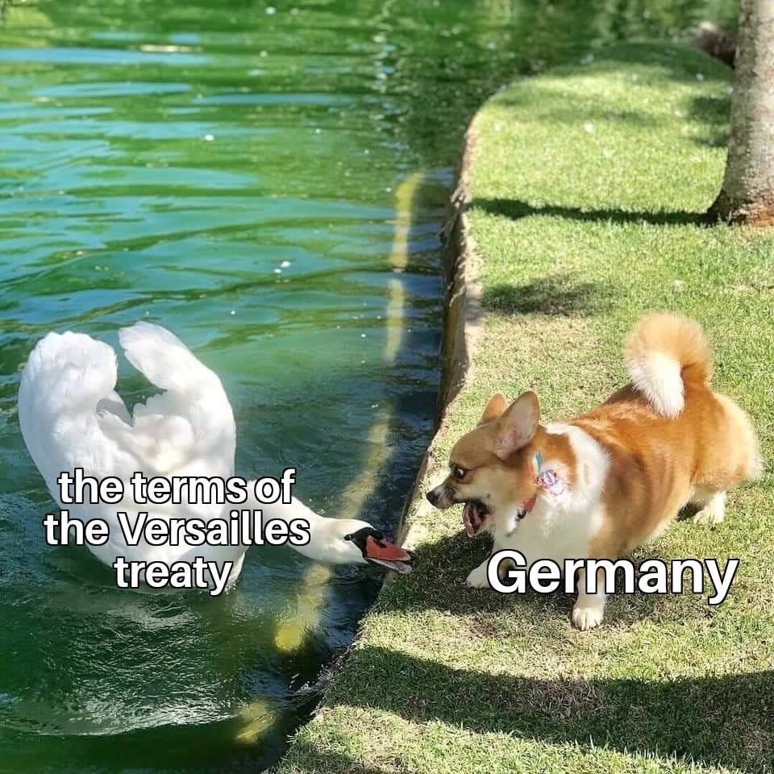
History Heroes Week 4

Slide 2
1. What date did Hitler become Chancellor (3 marks – day, month, year)

Slide 3
2. What was Goebbels’ main role in the Nazi Party? (1 mark)

Slide 4
3. Who were the Junkers? (1 mark)

Slide 5
4. The complex political maneuvering that led to Hitler gaining power in January 1933 involved four main people: (4 marks)

Slide 6
ANSWERS

Slide 7
1. What date did Hitler become Chancellor (3 marks – day, month, year)
30th January 1933

Slide 8
2. What was Goebbels’ main role in the Nazi Party? (1 mark)
Minister for Propaganda

Slide 9
3. Who were the Junkers? (1 mark)
Rich landowners and businessmen

Slide 10
4. The complex political maneuvering that led to Hitler gaining power in January 1933 involved four main people: (4 marks)
Adolf Hitler
President Hindenburg
Von Schleicher
Von Papen

Slide 11
RESULTS /9

Slide 12
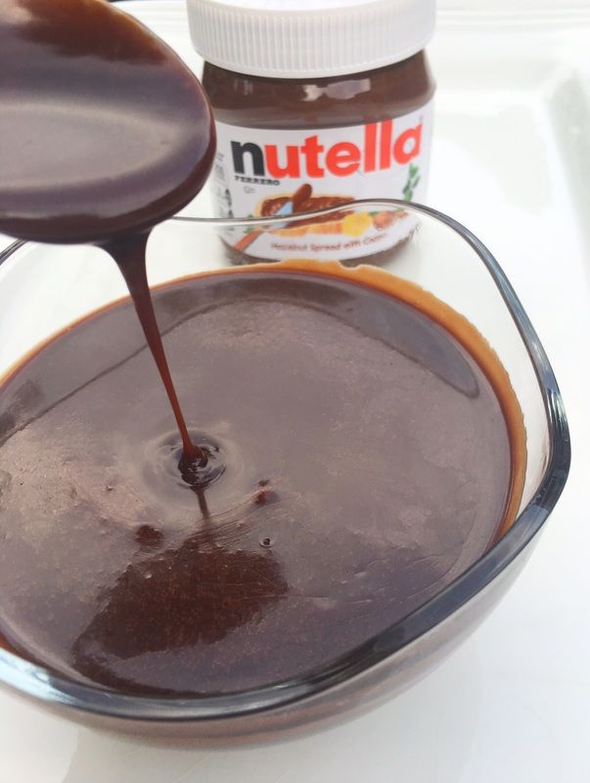
Source of the week

Slide 13
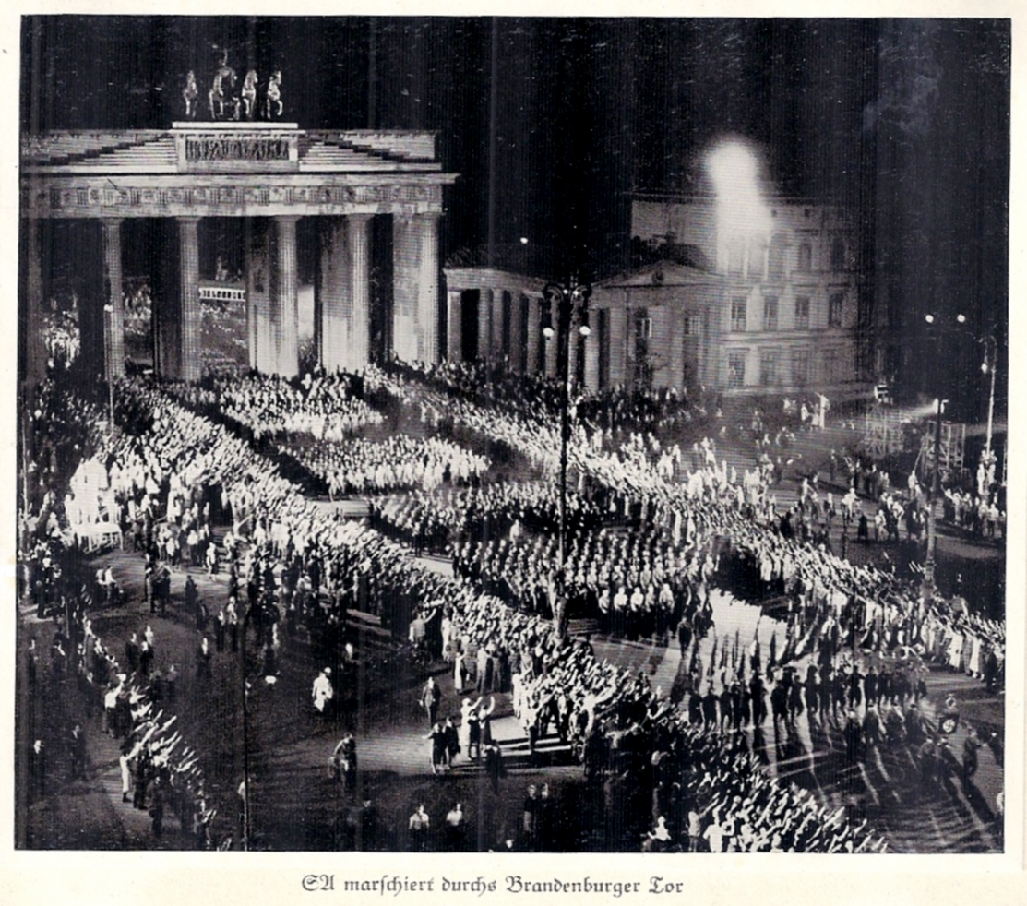
Nazi parade to celebrate Hitler’s appointment as Chancellor, 1933

